Slide 1

PRE-CLASS CONTENT Module 2.2 Method Of Proofs
DIRECT PROOF
INDIRECT PROOF
NESTED QUANTIFIERS

Slide 2
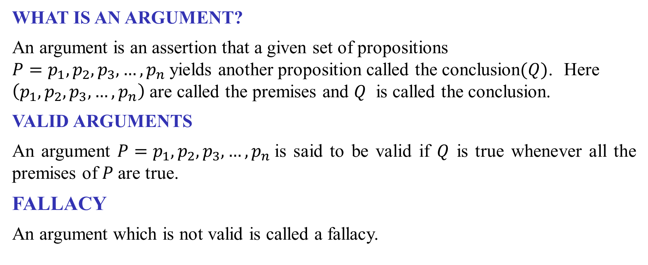
ARGUMENT
WHAT IS AN ARGUMENT?
An argument is an assertion that a given set of propositions ${P=p}_{1},p_{2},p_{3},…,p_{n}$yields another proposition called the conclusion$(Q)$. Here $\left(p_{1},p_{2},p_{3},…,p_{n}\right)$ are called the premises and $Q$ is called the conclusion.
VALID ARGUMENTS
An argument ${P=p}_{1},p_{2},p_{3},…{,p}_{n}$is said to be valid if $Q$ is true whenever all the premises of $P$are true.
FALLACY
An argument which is not valid is called a fallacy.

Slide 3
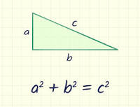
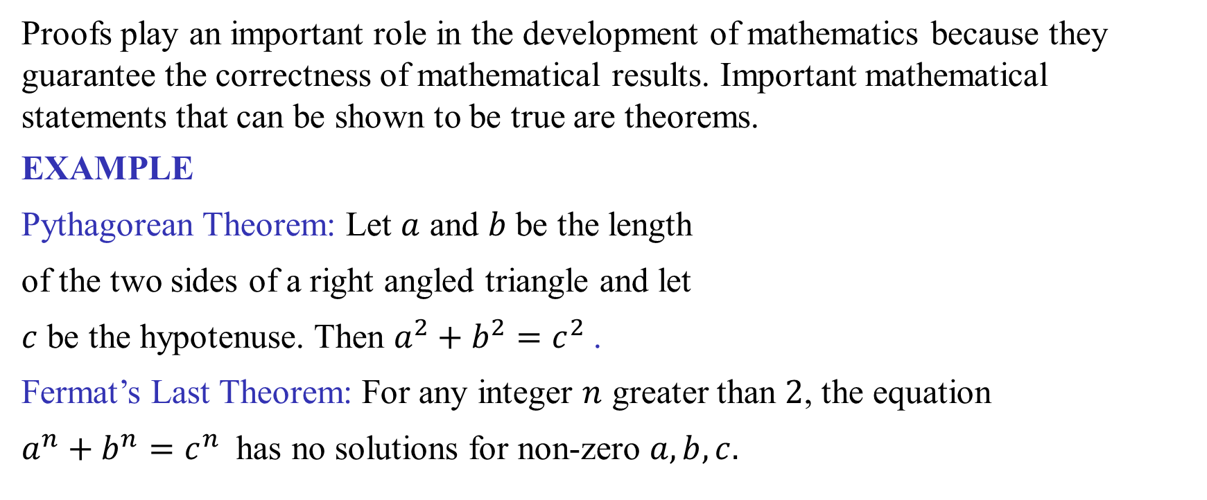
METHODS OF PROOFS
Proofs play an important role in the development of mathematics because they guarantee the correctness of mathematical results. Important mathematical statements that can be shown to be true are theorems.
EXAMPLE
Pythagorean Theorem: Let $a$ and $b$ be the length
of the two sides of a right angled triangle and let
$c$ be the hypotenuse. Then $a^{2}+b^{2}=c^{2}$.
Fermat’s Last Theorem: For any integer $n$ greater than $2$, the equation
$a^{n}+b^{n}=c^{n}$ has no solutions for non-zero $a, b, c.$

Slide 4
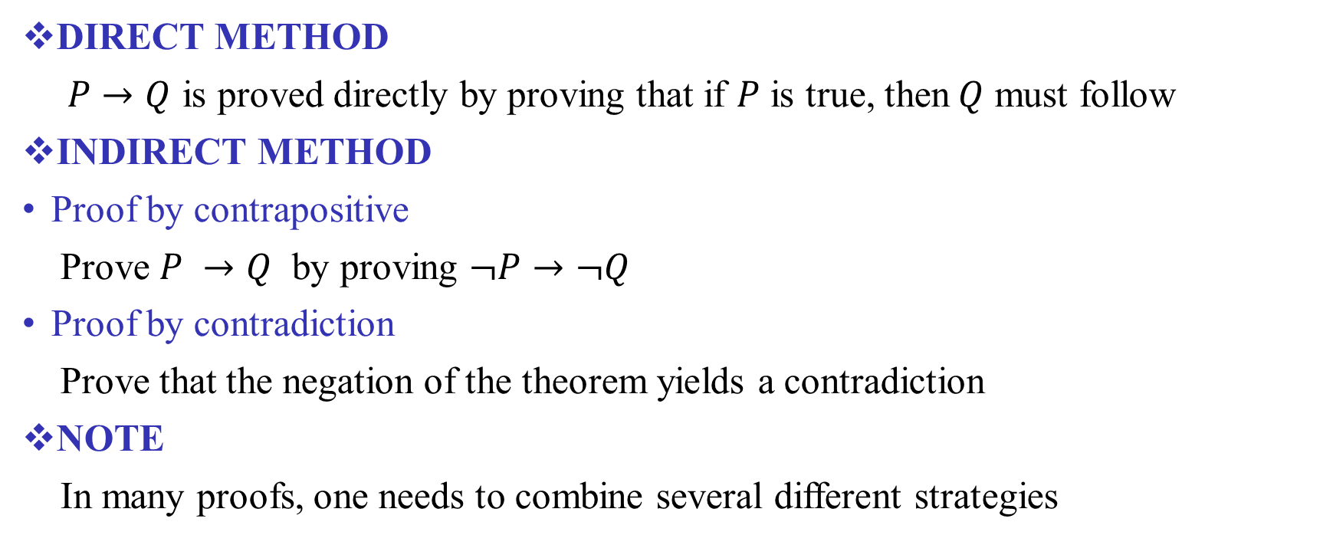
METHODS OF PROOFS Contd…
DIRECT METHOD
$P→Q$ is proved directly by proving that if $P$ is true, then$Q$ must follow
INDIRECT METHOD
Proof by contrapositive
Prove $P →Q$ by proving $¬P→¬Q$
Proof by contradiction
Prove that the negation of the theorem yields a contradiction
NOTE
In many proofs, one needs to combine several different strategies

Slide 5
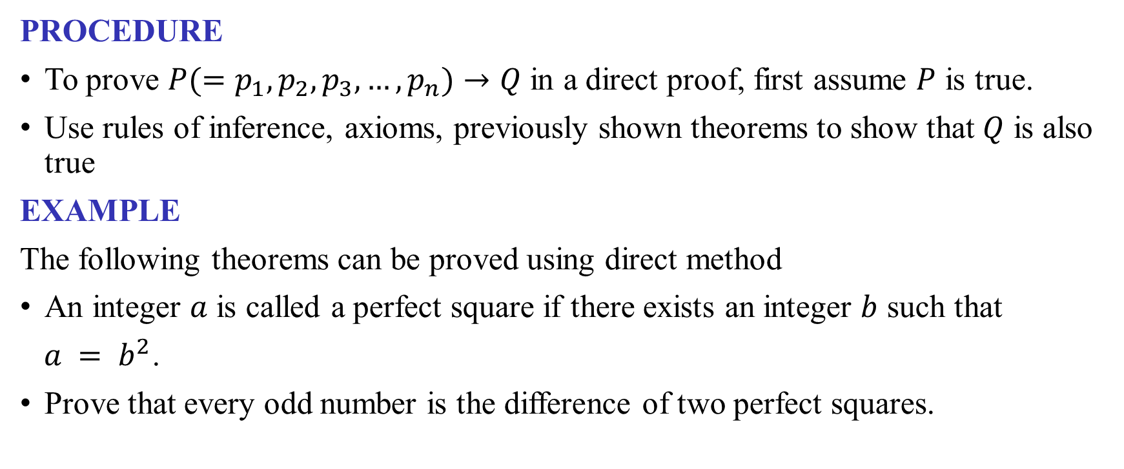
DIRECT METHOD
PROCEDURE
To prove $P(=p_{1},p_{2},p_{3},…,p_{n})→Q$ in a direct proof, first assume $P$ is true.
Use rules of inference, axioms, previously shown theorems to show that $Q$ is also true
EXAMPLE
The following theorems can be proved using direct method
An integer $a$ is called a perfect square if there exists an integer $b$ such that
$a = b^{2}$.
Prove that every odd number is the difference of two perfect squares.

Slide 6
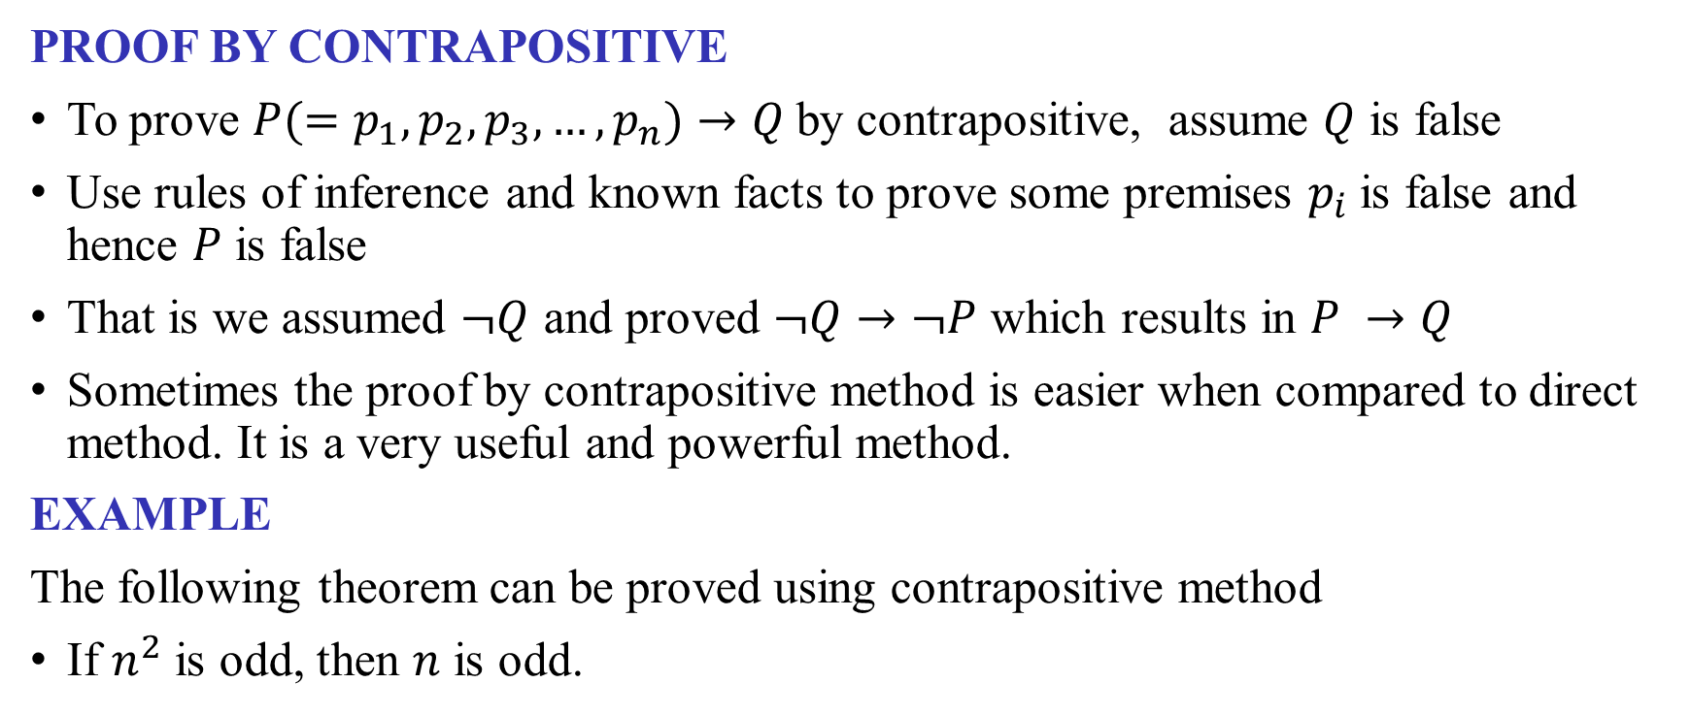
INDIRECT METHODS
PROOF BY CONTRAPOSITIVE
To prove $P(=p_{1},p_{2},p_{3},…,p_{n})→Q$by contrapositive, assume $Q$ is false
Use rules of inference and known facts to prove some premises $p_{i}$is false and hence $P$ is false
That is we assumed $¬Q$ and proved $¬Q→¬P$ which results in $P →Q$
Sometimes the proof by contrapositive method is easier when compared to direct method. It is a very useful and powerful method.
EXAMPLE
The following theorem can be proved using contrapositive method
If $n^{2}$ is odd, then $n$ is odd.

Slide 7
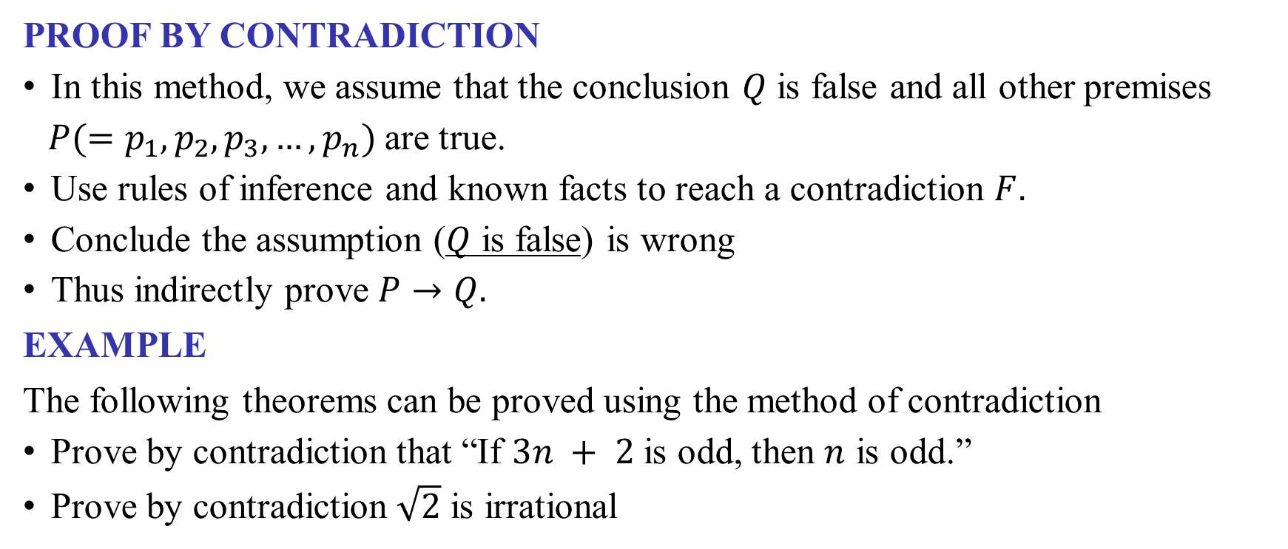
INDIRECT METHODS Contd…
PROOF BY CONTRADICTION
In this method, we assume that the conclusion $Q$ is false and all other premises
$P(=p_{1},p_{2},p_{3},…,p_{n})$are true.
Use rules of inference and known facts to reach a contradiction $F.$
Conclude the assumption ($Q$ is false) is wrong
Thus indirectly prove $P→Q.$
EXAMPLE
The following theorems can be proved using the method of contradiction
Prove by contradiction that “If $3n + 2$ is odd, then $n$ is odd.”
Prove by contradiction $\sqrt{2}$ is irrational

Slide 8
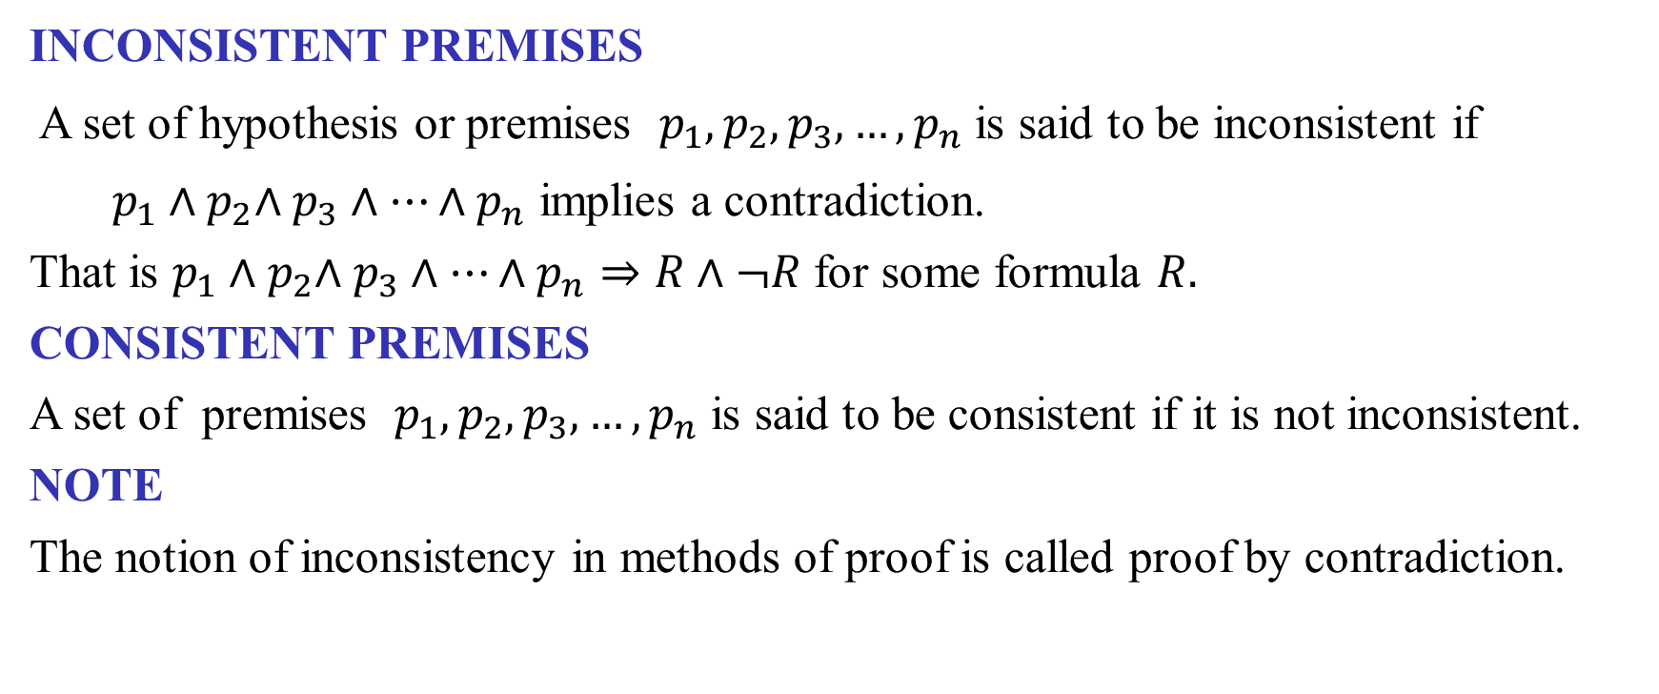
INCONSISTENT PREMISES
INCONSISTENT PREMISES
A set of hypothesis or premises $p_{1},p_{2},p_{3},…,p_{n}$ is said to be inconsistent if
$p_{1}{∧p}_{2}∧p_{3}∧…∧p_{n}$ implies a contradiction.
That is $p_{1}{∧p}_{2}∧p_{3}∧…∧p_{n}⇒R∧¬R$ for some formula $R.$
CONSISTENT PREMISES
A set of premises $p_{1},p_{2},p_{3},…,p_{n}$ is said to be consistent if it is not inconsistent.
NOTE
The notion of inconsistency in methods of proof is called proof by contradiction.

Slide 9
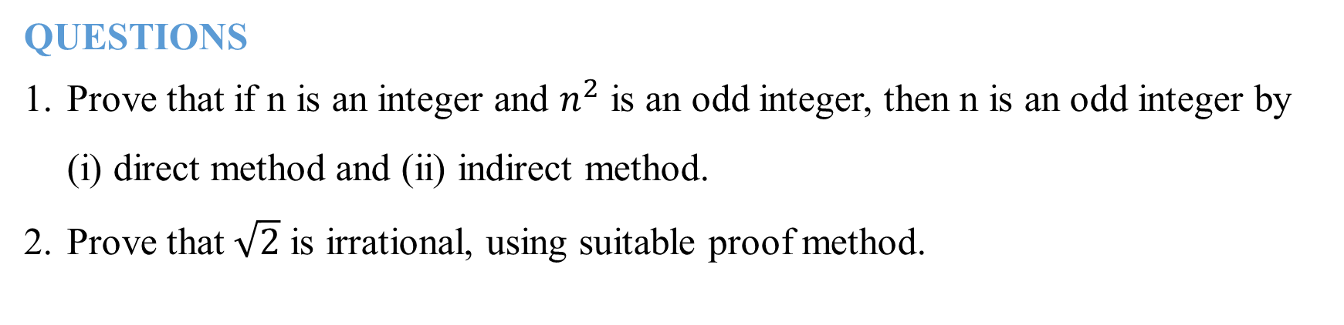
PROBLEMS
QUESTIONS
Prove that if n is an integer and $n^{2}$ is an odd integer, then n is an odd integer by (i) direct method and (ii) indirect method.
Prove that $\sqrt{2}$ is irrational, using suitable proof method.

